Slide 1
Reducing Childhood Obesity case studies from local, national and international projects
Michael Baber
Director, Health Action Campaign

Slide 2
Obesity: Why prevention is better than cure
Only 2% of obese men and 3% of obese women in the UK are likely to get back to a healthy weight over a 9 year period
Obese parents are more likely to have obese children
Obese parents are less likely to recognise their children are obese

Slide 3
Understanding the causes of Obesity Too much of the wrong kinds of food and drink
Supersizing (2 litre Coke bottles, 1978 i.e. 10 times the original size)
Ready meals (the microwave 1984)
Fast Food, Takeaways & Home Delivery in the UK (£30 billion p.a.)
Soft drinks in the UK (£10 billion p.a.)
Food & Drink advertising in the UK (£1 billion p.a.)
Less breastfeeding/more use of formula milk and sweet baby foods

Slide 4
Preventing childhood obesity: one-off initiatives
Small scale, Short term, Ad hoc interventions
Usually don’t have positive outcomes – but a few exceptions.
Healthy Beginnings Trial (Sydney: 2007-2010)
Regular home visits by specially trained community nurses (antenatal – 24months)
Lower BMI vs control group, though obesity returned when intervention stopped.
Infant, Feeding, Activity and Nutrition Trial (InFant) (Melbourne: 2008-2010)
Dieticians worked with established first time parents groups. Positive action taken by parents, although varied according to their age and education.

Slide 5
Four ‘Whole Systems’ interventions
Romp & Chomp
EPODE (Ensemble Prevenons l’Obesite Des Enfants)
JOGG (Jongeren op Gezond Gewicht)
TCOCT (The Children’s Obesity Clinic Treatment Protocol)

Slide 6
Romp & Chomp Geelong, Australia 2004–2008
What was it?
Healthy eating and active play with a target group of 12,000 children
Community-wide, multi-setting, multi-strategy – which reduced obesity
What helped?
Capacity building and Sustainable partnerships
Specialist advice and Integration into formal training of childcare workers
What challenges were identified?
Limited funding and High staff turnover
More parent engagement needed and Lack of high level leadership

Slide 7
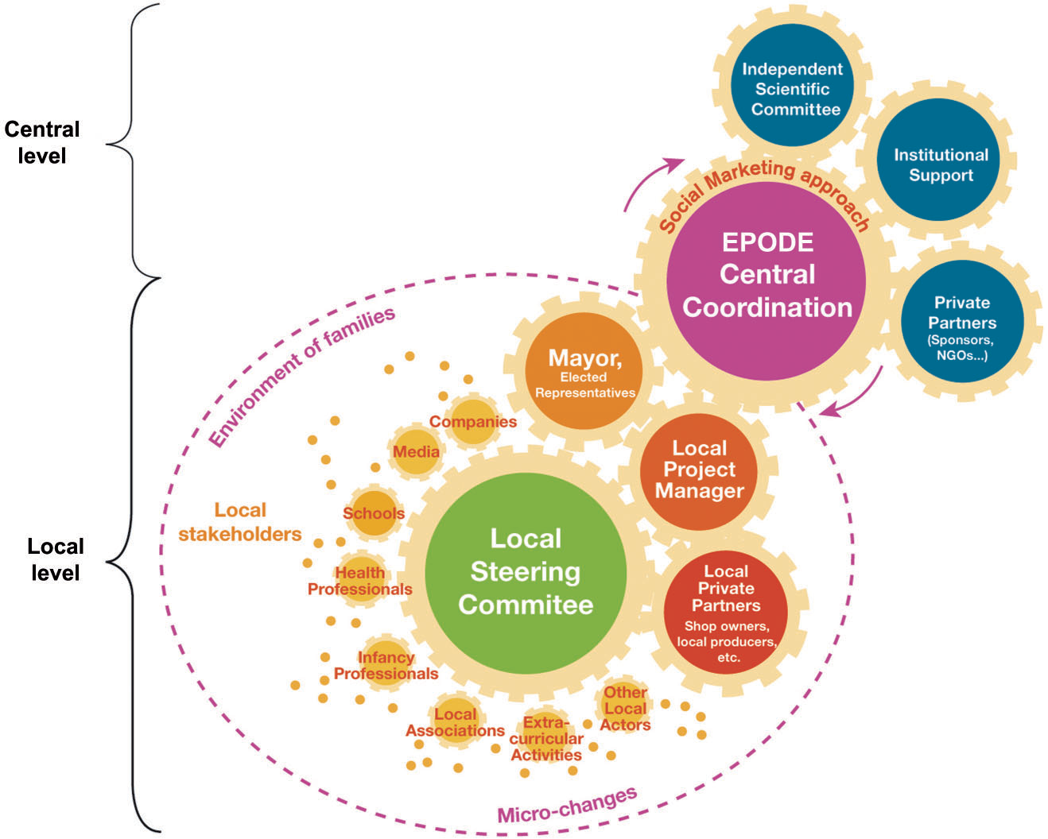
EPODE (France 2004–2018 /FLVS 1992–2004)

Slide 10
The Children’s Obesity Clinic Treatment (Holbaek, Denmark 2008-2018)
Treats obesity as a chronic disease
Children with weight problems referred to hospital
Seen by a paediatrician and a dietitian
Plus a paediatric nurse, a psychologist or a social worker if needed
Teach parents how to control their children’s environment e.g. no 2nd helpings for 20 mins, no TV before 5pm, pocket money in a bank account
Successfully replicated elsewhere in Denmark

Slide 11
A whole systems approach in the UK
To identify how local authorities can make greater in-roads into tackling obesity by taking a more ‘whole systems’ approach
Local Government Association
Public Health England
Leeds Becket University
Association of Directors of Public Health

Slide 12
Voluntary, Statutory or Third Way?
Voluntary e.g. Responsibility Deal, 2016 Childhood Obesity Plan and LGA/PHE Whole Systems pilots
Statutory e.g. Soft Drinks levy, Calorie labelling and proposed 9 pm watershed for HFSS advertising
Third Way e.g. Elected Mayors + health remit + Tackling Obesity Fund - to reduce childhood obesity across 40% of England

Slide 13
Social Marketing - Generation Z
The healthiest generation?
Smoke less, drink less alcohol, exercise more and eat more healthily (ONS/NHS)
‘Whole systems’ social marketing campaign to reduce sugar consumption
Health experts AND celebrity chefs
Extensive media AND social media coverage
Student Health Behaviour Change study (Perspect Public Health 2018)
68.2% of 18-21 year olds were trying to avoid sugary drinks
72.4% healthy weight, 12.8% underweight and 14.8% overweight

Slide 14
Social Marketing – to the Food & Drinks Industry
What are your target audience’s needs, wants and concerns?
Profits, Customer response, Feasibility and Affordability
How to recognise and meet those concerns
a) Customer lifetime value – health conscious consumers spend more, live longer
b) Consumer research feedback – demand for healthier food continues to grow
c) Reformulation is a core skill, specialist help available, R&D corporation tax relief + new options e.g. Soda-Lo and flavour delivery particles
Potential for Diversification
e.g. Coca Cola launching 3 new drinks below the sugar tax threshold in 2018
e.g. PepsiCo now owns Quaker Oats and has just acquired Health Warrior

Slide 15
Conclusions
Prevention is better than cure, so first prevent childhood obesity
Big problems need big solutions, so every available lever needs to be used – including the potential of Elected Mayors
Whole systems approaches currently work best
Generation Z – a positive trend to build on?
Use Social Marketing to change Food & Drink industry behaviour, not just the behaviour of individual consumers

Slide 16
References
1. Fildes A, Charlton J, Rudisill C et al. Probability of an obese person attaining normal body weight: cohort study using electronic health records. American Journal of Public Health September 2015. http://ajph.aphapublications.org/doi/pdf/10.2105/AJPH.2015.302773
2. Wen LM, Baur LA, Simpson JM. Sustainability of effects of an early childhood obesity prevention trial over time: A further 3-year follow-up of the healthy beginnings trial. JAMA Pediatr. 2015 Jun;169:543-51
3. Cameron AJ, Ball K, Hesketh KD. Variation in outcomes of the Melbourne infant, feeding, activity and nutrition trial (InFANT) program according to maternal education and age. Prev Med. 2014;58:58-63.
4. Keita AD, Risica PM, Drenner KL. Feasibility and acceptability of an early childhood obesity prevention intervention: Results from healthy homes, healthy families pilot study. J Obesity 2014 http://www.hindawi.com/journals/jobe/2014/378501/
5. De Silva-Sanigorski A, Bell AC, Kremer P Reducing obesity in early childhood: results from Romp & Chomp, an Australian community-wide intervention program The American Journal of Clinical Nutrition, Volume 91, Issue 4, 1 April 2010, Pages 831–840, https://doi.org/10.3945/ajcn.2009.28826
6. Romon M, Lommez A, Tafflet M et al. Downward trends in the prevalence of childhood overweight in the setting of 12 year school and community based programmes Public Health Nutrition 2008 (NB This study focused on a precursor to EPODE, which EPODE then developed further).
7. Borys J-M, Valdeyron L, Levy E et al. EPODE – A Model for Reducing the Incidence of Obesity and Weight-related Comorbidities. Eur Endocrinol. 2013 Aug; 9(2): 116–120.
8. JOGG Jongeren op Gezond Gewicht- JOGG (Young people at a Healthy Weight) Marieke Hendriksen National JOGG Project Bureau 2017
9. Holm JC, Gamborg M, Bille DS et al. Chronic care treatment of obese children and adolescents Int J Pediatr Obes. 2011 Aug;6(3-4):188-96
10. Most SW, Højgaard B, Teilmann G Adoption of the children’s obesity clinic’s treatment (TCOCT) protocol into another Danish pediatric obesity treatment clinic BMC Pediatrics 2015 15:13
11. Haas J, Baber M, Byrom N et al. Changes in student physical health behaviour: an opportunity to turn the concept of a Healthy University into a reality Perspectives in Public Health November 2018

